Slide 1
Department of CSE
COURSE NAME: Data science
COURSE CODE: 24AD3107
Topic:
Dash Boards in Python
Session - 9

Slide 2
AIM OF THE SESSION
To familiarize students with the basic concepts of Dash Boards in Python.
INSTRUCTIONAL OBJECTIVES
This Session is designed to: Introduction to Dashboards and Implementation of Dashboards using Python.
LEARNING OUTCOMES
At the end of this session, you should be able to: create dash boards using python

Slide 3
Key Concepts
SESSION INTRODUCTION
Introduction to Dashboards
Creation of dashboards using python
Case study

Slide 4
Introduction Dash Boards
A dashboard is an interactive interface that displays data visualizations, metrics, and controls in one place.
In Python, dashboards are often used for data analysis, monitoring, and reporting without needing deep front-end development skills.
Popular Python Dashboard Frameworks
Dash (by Plotly)
  Pure Python framework for building interactive web apps.
  Uses Flask (backend), Plotly (charts), and React.js (frontend).
  No need to write HTML/CSS/JS manually.
  Great for data scientists and analysts.
Streamlit
  Very simple syntax, like writing a Python script.
  Ideal for quick prototypes and sharing ML models.
  Less control over layout compared to Dash.
Panel / Bokeh
  Flexible, supports multiple plotting libraries (Matplotlib, Bokeh, Plotly).
  Good for scientific dashboards.

Slide 5
why Use Dashboards in Python?
Interactive: Users can filter, zoom, and explore data.
Real-time updates: Connect to live data sources.
Shareable: Deploy as a web app for others to use.
No heavy front-end coding: Write mostly Python.
Introduction to Dash in Python
Dash is a Python framework for building analytical web applications. Dash helps in building responsive web dashboards that is good to look at and is very fast without the need to understand complex front-end frameworks or languages such as HTML, CSS, JavaScript. Let's build our first web dashboard using Dash.
Installation and Imports
Install the latest version of Dash
Syntax: !pip install dash
Creating a Simple Dash Board:

Slide 6
Step 1: Importing all the required libraries Now let's import Dash, Dash Core Components(which has components like graph, inputs etc., ) and Dash HTML Components(which has HTML components like meta tags, body tags, paragraph tags etc., )
# importing required libraries
import dash
import dash_core_components as dcc
import dash_html_components as html
Step 2: Designing a layout : HTML components are just like HTML. Here html.H1 refers to the h1 tag in HTML. Then, we make a graph which has various parameters such as id(a unique ID to a particular graph), figure(the graph itself), layout(the basic layout, title of graph, X axis, Y axis data etc., ).The figure parameter is essentially a dictionary which has elements like x, y, type, name.
x refers to the X-axis value(it can be a list or a single element), y is the same except it is associated with the Y-axis.
The type parameter refers to the type of the graph, it maybe line, bar.
The name parameter refers to the name associated with the axis of a graph

Slide 7
app = dash.Dash()
app.layout = html.Div(children =[
html.H1("Dash Tutorial"),
dcc.Graph(
id ="example",
figure ={
'data':[
{'x':[1, 2, 3, 4, 5],
'y':[5, 4, 7, 4, 8],
'type':'line',
'name':'Trucks'},
{'x':[1, 2, 3, 4, 5],
'y':[6, 3, 5, 3, 7],
'type':'bar',
'name':'Ships'}
],
'layout':{
'title':'Basic Dashboard'
}
}
)
])

Slide 8
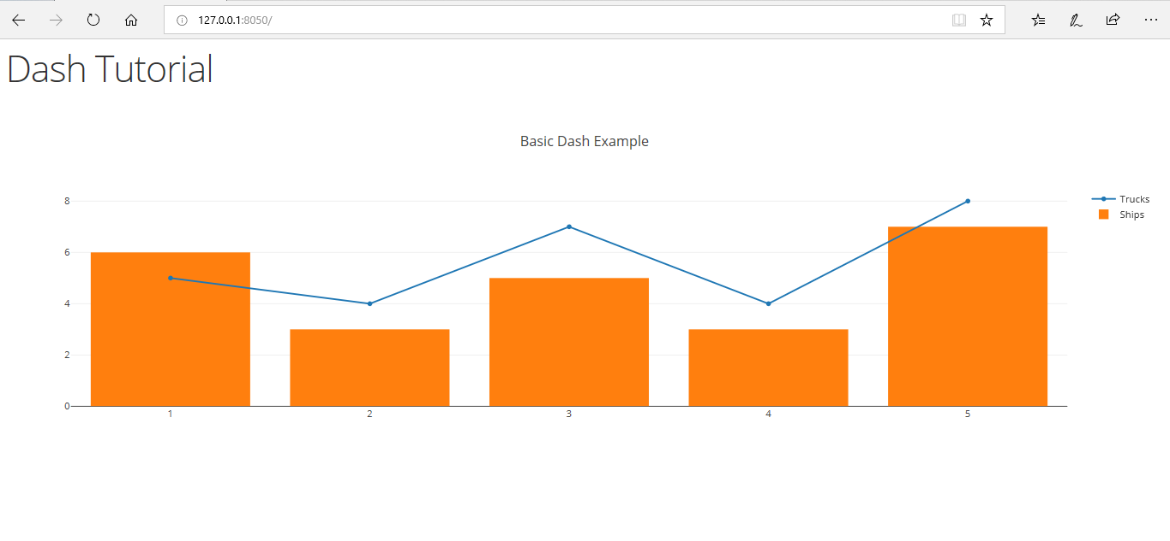
Step 3: Running the server The dashboard is now ready, but it needs a server to run on. Thus we set up the server using the below code.
if __name__ == '__main__':
app.run_server()
Open the app on the web browser in localhost and default port 8050.
http://127.0.0.1:8050/

Slide 9
Using Callbacks
The above teaches us a basic static app. But what if you want to let the user take the control. This is why we are going to use app callbacks provided in Dash. In this section, we are going to make a web app that takes in number from the user and return the square of the number
Step 1: Importing all the required libraries Just like above we are going to import all the required libraries. Here we require an additional dash.dependencies.Input and dash.dependencies.Output to provide us with input and output callback functionality.
# importing required libraries
import dash
import dash_core_components as dcc
import dash_html_components as html
from dash.dependencies import Input, Output
Step 2: Designing a layout We are going to design a simple textbox that will help out take input and a text label which will output the square of the number that is input or returns an error if the input is not a number.
app = dash.Dash()
app.layout = html.Div(children =[
dcc.Input(id ='input',
value ='Enter a number',
type ='text'),
html.Div(id ='output')
])

Slide 10
Step 3: Callbacks A callback is like a trigger that does a certain function on the change of the state of the input. In this case, it executes the method update_value and takes in input_data as the parameter and returns the square of that number. If the input is not a number, then it returns an error statement.
@app.callback(
Output(component_id ='output', component_property ='children'),
[Input(component_id ='input', component_property ='value')]
)
def update_value(input_data):
try:
return str(float(input_data)**2)
except:
return "Error, the input is not a number“
Step 3: Running the server Again, just like above, we are going to run the server.
if __name__ == '__main__':
app.run_server()

Slide 11
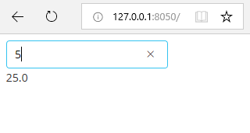
Open the app on the web browser in local host and default port 8050.
http://127.0.0.1:8050/

Slide 12
REFERENCES FOR FURTHER LEARNING OF THE SESSION
Text Books:
Introduction to Data Science- A Structured Methodology,Goran trajkovski.
Data Science from Scratch- Joel Grus - O’Reilly - 2015
Practical Statistics for Data Scientists - Peter Bruce, Andrew Bruce & Peter Gedeck - O’Reilly - 2020
Data Science and Machine Learning (Mathematical and Statistical Methods) - Dirk P. Kroese, Zdravko I. Botev, Thomas Taimre, Radislav Vaisman- Chapman and Hall/CRC - 2025
Foundations of Data Science - Avrim Blum, John Hopcroft, and Ravindran Kannan - Cambridge University Press – 2020
Reference Books:
R1.Data Science and Its Applications by Aakanksha Sharaff and G. R. Sinha.
R2. Introducing Data Science Big Data, Machine Learning, and more using Python tools. by Davy cielen, Arno D.B. Meysman and Mohamed Ali.

Slide 13

THANK YOU
Team – DS

